Slide 1
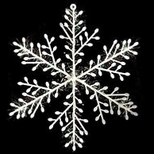
Sirius Snow Day Work
Monday 6th January 2025

Slide 2
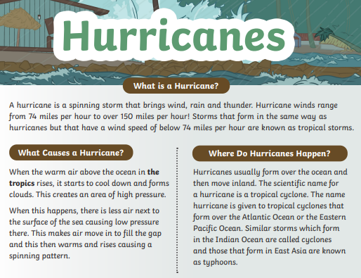
English Comprehension
Read the text and answer the questions.

Slide 3
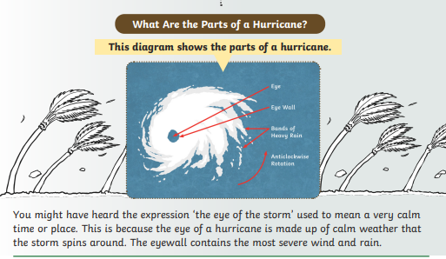

Slide 4
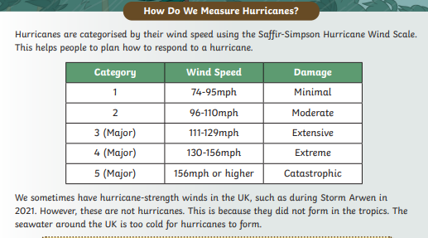

Slide 5
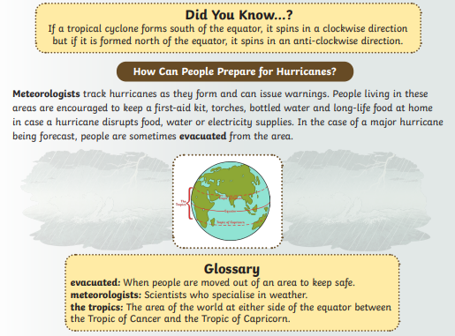

Slide 6
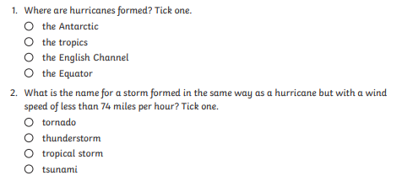
Questions:

Slide 7
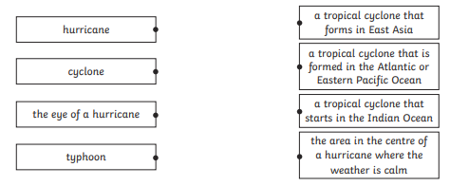
Questions:
Which definition matches the word?
A
B
C
D
1
2
3
4

Slide 8
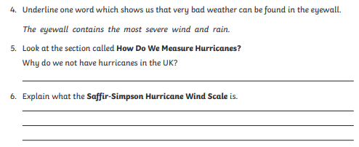
Questions:
Which word shows us that very bad weather can be found in the eyewall?

Slide 9
Mental Maths

Slide 10
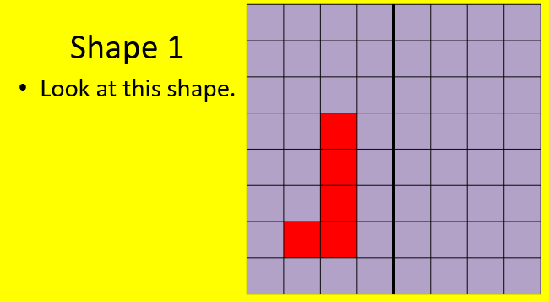
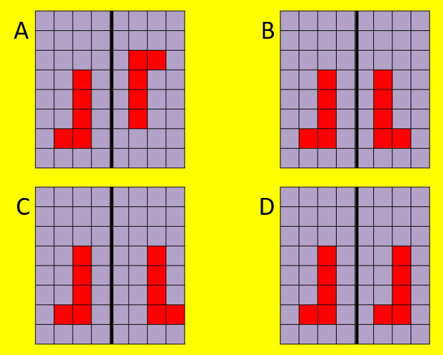
Maths Reflection
Which shape has been vertically reflected? Is it A,B,C or D?

Slide 11
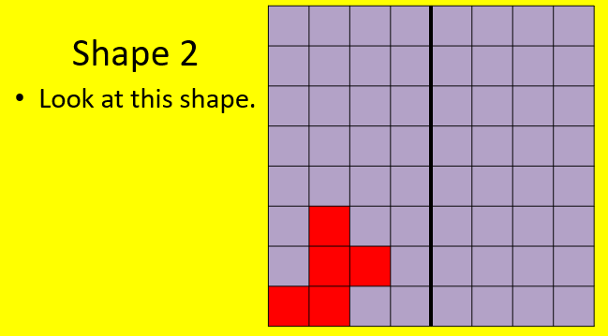
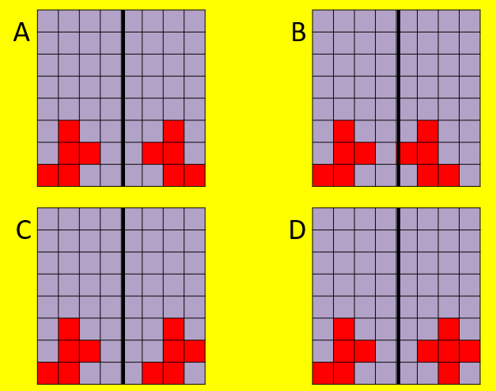
Maths Reflection
Which shape has been vertically reflected? Is it A,B,C or D?

Slide 12
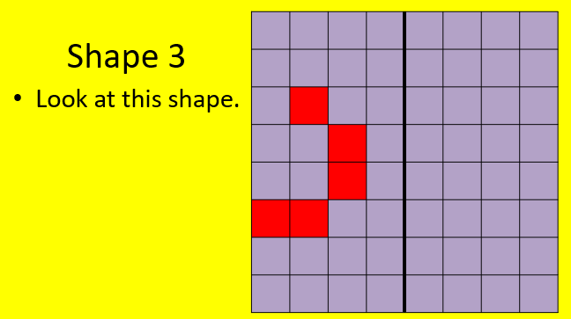
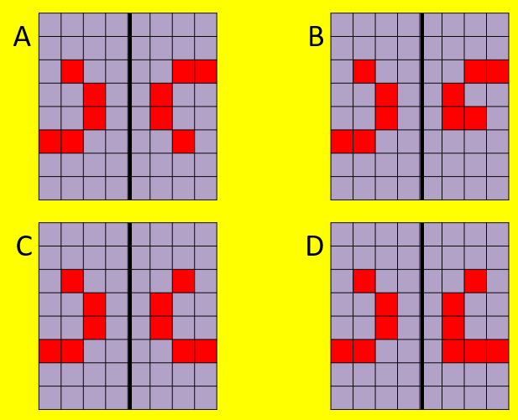
Maths Reflection
Which shape has been vertically reflected? Is it A,B,C or D?

Slide 13
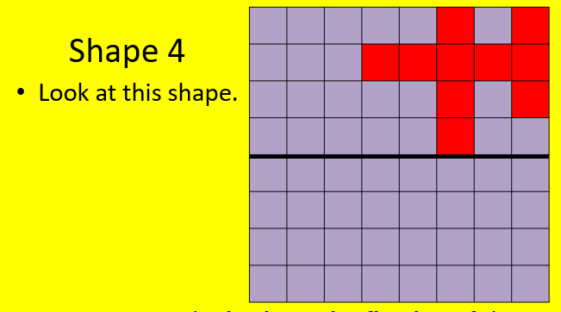
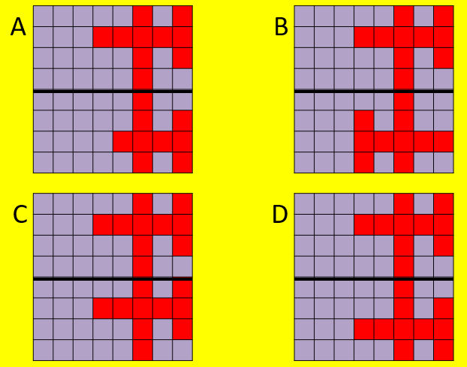
Maths Reflection
Which shape has been horizontally reflected? Is it A,B,C or D?

Slide 14
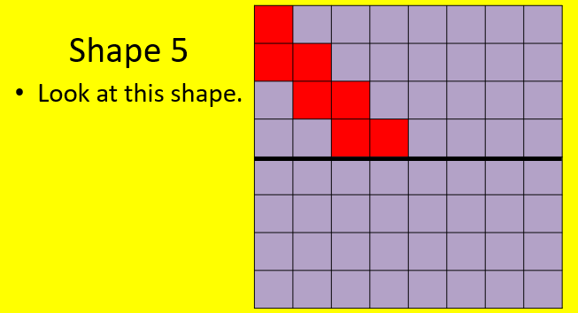
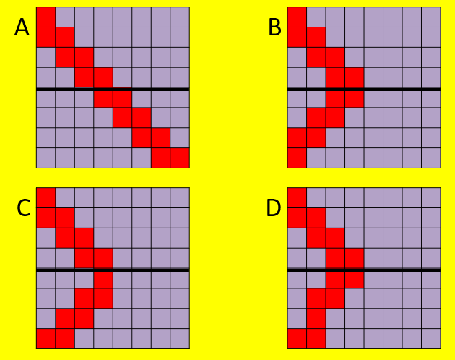
Maths Reflection
Which shape has been horizontally reflected? Is it A,B,C or D?

Slide 15
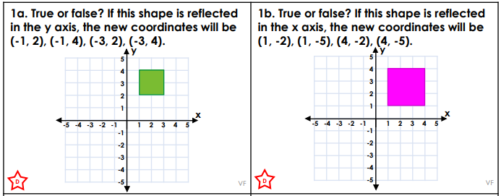
Maths Reflection

Slide 16
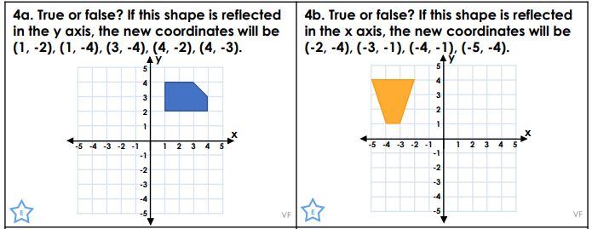
Maths Reflection

Slide 17
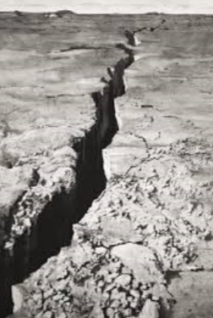
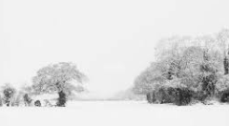
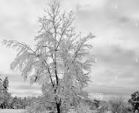
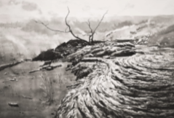
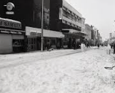
Art Sketch a scene of the snow in the style of Emma Stibbon.
Look outside at the natural world and the snow. Sketch an image of it using only monochrome in the style of Emma Stibbon. We looked at her work last term. If you have any paint or back pencils you can add tone and shade to your picture.
Examples of snow in monochrome.
Here are some examples to remind you.

Slide 18
Extra Tasks
Practise your times tables on TT Rockstars
Read your reading book

